Slide 1

Text Classification with Spark
Rich Tarro October 19, 2016
IBM Big Data Architect
rtarro@us.ibm.com

Slide 2
Agenda
Apache Spark
Spark MLlib
Text Classification with Spark
Some other Machine Learning Concepts
Demo
Wrap-up

Slide 3
Agenda
Apache Spark
Spark MLlib
Text Classification with Spark
Some other Machine Learning Concepts
Demo
Wrap-up

Slide 4
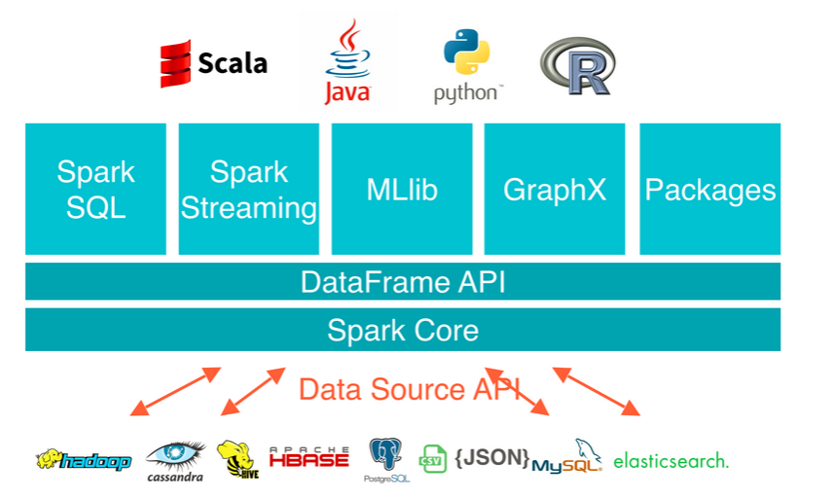
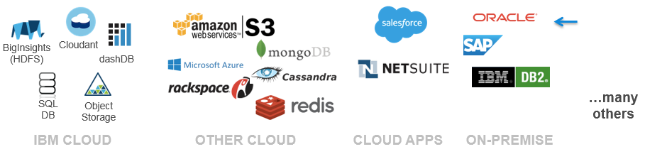
Apache Spark

Slide 5
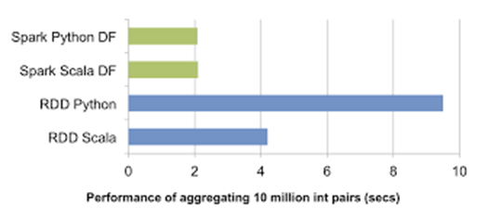
Spark Abstractions
Resilient Distributed Dataset (RDD)
Represents an immutable, partitioned collection of elements that can be operated on in parallel
DataFrames
A distributed collection of data organized into named columns
Conceptually equivalent to a table in a relational database or a data frame in R/Python
Makes Spark programs simpler and easier to develop and understand
Automatically optimized

Slide 6

Jupyter Notebook
Based on IPython
Browser-based document that supports code, text, interactive visualization, math, and media
Interactive, iterative, and collaborative work environments for programming and analytics
Living documents that are very easy to use by both technical and LOB users
Can take you from a concept to deploying an application in a single environment

Slide 7
Agenda
Apache Spark
Spark MLlib
Text Classification with Spark
Demo
Questions/Next Steps

Slide 8

Spark MLlib
MLlib is Spark’s machine learning (ML) library
Its goal is to make practical machine learning scalable and easy
Consists of common learning algorithms and utilities, including
Classification
Regression
Clustering
Collaborative filtering
Dimensionality Reduction
Lower-level optimization primitives
Higher-level pipeline APIs

Slide 9
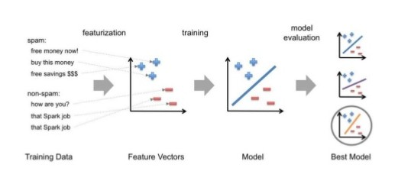
Typical Steps in ML Pipeline

Slide 10
Agenda
Apache Spark
Spark MLlib
Text Classification with Spark
Some other Machine Learning Concepts
Demo
Wrap-up

Slide 11
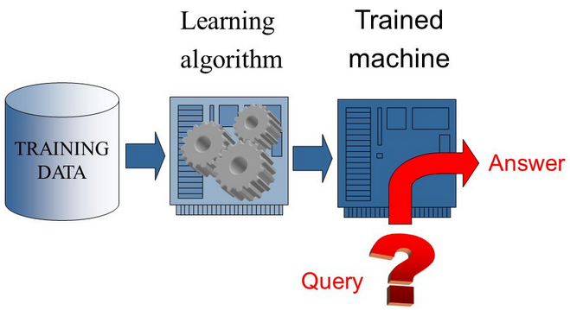
Machine Learning
Supervised learning
The program is “trained” on a pre-defined set of “training examples”, which then facilitate its ability to reach an accurate conclusion when given new data
Unsupervised learning
No labels are given to the learning algorithm, leaving it on its own to find structure (patterns and relationships) in its input

Slide 12

Classification
Classification aims to divide items into categories
The most common classification type is binary classification (two categories)
If there are more than two categories, it is called multiclass classification
Logistic regression is a popular method to predict a binary response
It is a special case of Generalized Linear models that predict the probability of an outcome
Binary logistic regression can be generalized into multinomial logistic regression to train and predict multiclass classification problems
The current implementation of logistic regression in spark.ml only supports binary classes. Support for multiclass regression will be added in the future.

Slide 13
Spark ML Pipeline Terminology
Spark ML standardizes APIs for machine learning algorithms to make it easier to combine multiple algorithms into a single pipeline, or workflow
Transformer: A Transformer is an algorithm which can transform one DataFrame into another DataFrame
Estimator: An Estimator is an algorithm which can be fit on a DataFrame to produce a Transformer
Pipeline: A Pipeline chains multiple Transformers and Estimators together to specify an ML workflow
Parameter: All Transformers and Estimators share a common API for specifying parameters

Slide 14

Transformers
A Transformer is an abstraction that includes feature transformers and learned models
A Transformer implements a method transform(), which converts one DataFrame into another, generally by appending one or more columns
For example:
A feature transformer might take a DataFrame, read a column (e.g., text), map it into a new column (e.g., feature vectors), and output a new DataFrame with the mapped column appended
A learning model might take a DataFrame, read the column containing feature vectors, predict the label for each feature vector, and output a new DataFrame with predicted labels appended as a column

Slide 15

Some Feature Transformers for Text Classification
Tokenizer
Tokenization is the process of taking text (such as a sentence) and breaking it into individual terms (usually words)
StopWordsRemover takes as input a sequence of strings (e.g. the output of a Tokenizer) and drops all the stop words from the input sequences
Stop words are words which should be excluded from the input, typically because the words appear frequently and don’t carry as much meaning
Spark Mllib provides a list of stop words by default

Slide 16

More Feature Transformers for Text Classification
Term Frequency-Inverse Document Frequency (TF-IDF) is a common text pre-processing step
In Spark ML, TF-IDF is separated into two parts: TF (+hashing) and IDF
TF: HashingTF is a Transformer which takes sets of terms and converts those sets into fixed-length feature vectors
The algorithm combines Term Frequency (TF) counts with the hashing for dimensionality reduction
IDF: IDF is an Estimator which fits on a dataset and produces an IDFModel
The IDFModel takes feature vectors (generally created from HashingTF) and scales each column
IDF “down-weights” columns which appear frequently in a corpus

Slide 17

Estimators
An Estimator abstracts the concept of an algorithm that fits or trains on data
An Estimator implements a method fit(), which accepts a DataFrame and produces a Model (which is a Transformer)
For example:
A learning algorithm such as LogisticRegression is an Estimator
Calling fit() trains a LogisticRegressionModel, which is a Model (a Transformer)

Slide 18
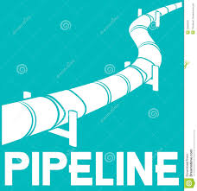
Pipelines
A Pipeline is specified as a sequence of stages where each stage is either a Transformer or an Estimator
These stages are run in order and the input DataFrame is transformed as it passes through each stage
For Transformer stages, the transform() method is called on the DataFrame
For Estimator stages, the fit() method is called to produce a Transformer (which becomes part of the fitted Pipeline), and that Transformer’s transform() method is called on the DataFrame
For example, a simple text document processing workflow might include several stages:
Split each document’s text into words
Convert each document’s words into a numerical feature vector
Learn a prediction model using the feature vectors and labels

Slide 19
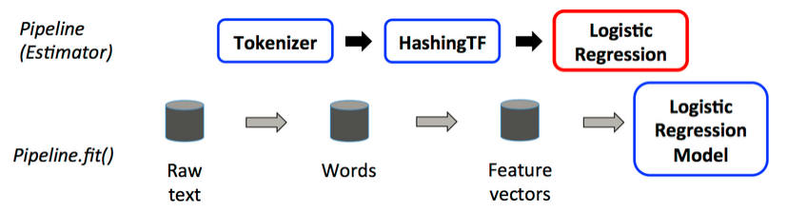
Example Text Document Pipeline – training time usage
A Pipeline is an Estimator

Slide 20
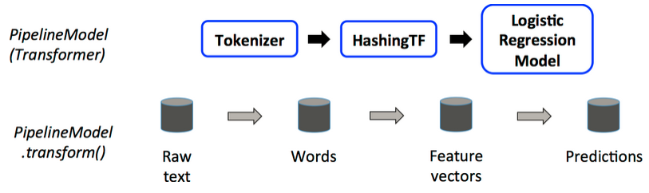
PipelineModel – used at test time
After a Pipeline’s fit() method runs, it produces a PipelineModel, which is a Transformer
When the PipelineModel’s transform() method is called on a test dataset, the data are passed through the fitted pipeline in order
Each stage’s transform() method updates the dataset and passes it to the next stage
Pipelines and PipelineModels help to ensure that training and test data go through identical feature processing steps

Slide 21
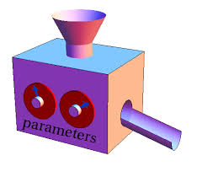
Parameters
Spark ML Estimators and Transformers use a uniform API for specifying parameters
A Param is a named parameter with self-contained documentation
A ParamMap is a set of (parameter, value) pairs
There are two main ways to pass parameters to an algorithm:
Set parameters for an instance
For example: if lr is an instance of LogisticRegression, one could call lr.setMaxIter(10) to make lr.fit() use at most 10 iterations
Pass a ParamMap to fit() or transform()
Any parameters in the ParamMap will override parameters previously specified via setter methods.
Parameters belong to specific instances of Estimators and Transformers

Slide 22
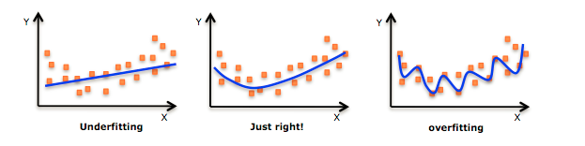
Model Selection via Cross Validation
An important task in ML is model selection
using data to find the best model or parameters for a given task
Pipelines facilitate model selection by making it easy to tune an entire Pipeline at once, rather than tuning each element in the Pipeline separately
Currently, spark.ml supports model selection using the CrossValidator class, which takes as input an Estimator, a set of ParamMaps, and an Evaluator
CrossValidator iterates through the set of ParamMaps
For each ParamMap, it trains the given Estimator and evaluates it using the given Evaluator

Slide 23
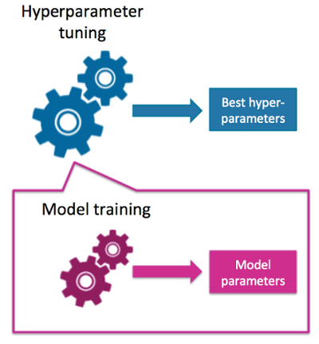
Tuning a Spark ML Model - Hyperparameters
Spark ML algorithms provide many hyperparameters for tuning models
These hyperparameters are distinct from the model parameters being optimized by ML itself
Hyperparameter tuning is accomplished by choosing the best set of parameters based on model performance on test data that the model was not trained with

Slide 24
Agenda
Apache Spark
Spark MLlib
Text Classification with Spark
Some other Machine Learning Concepts
Demo
Wrap-up

Slide 25
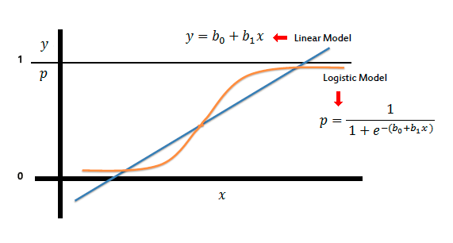
Logistic Regression
Logistic regression is a popular method to predict a binary response

Slide 26
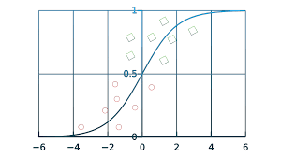
Logistic Regression Threshold
Default threshold = 0.5 shown
Class Probability
Feature

Slide 27
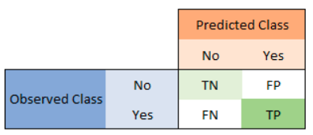
Model Performance and the Confusion Matrix
Accuracy =(TN+TP)/(TN+FP+FN+TP)
Precision =TP/(FP+TP)
Sensitivity =TP/(TP+FN)
Specificity =TN/(TN+FP)
TN True Negative
FP False Positive
FN False Negative
TP True Positive

Slide 28
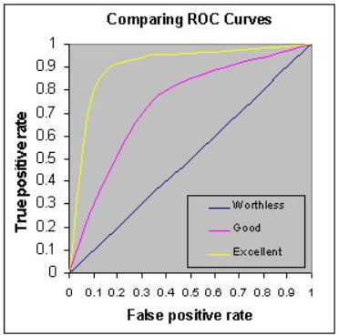
Receiver Operating Characteristic (ROC) curve
ROC curve is a graphical plot that illustrates the performance of a binary classifier system as its discrimination threshold is varied
Created by plotting the true positive rate against the false positive rate at various threshold settings.

Slide 29
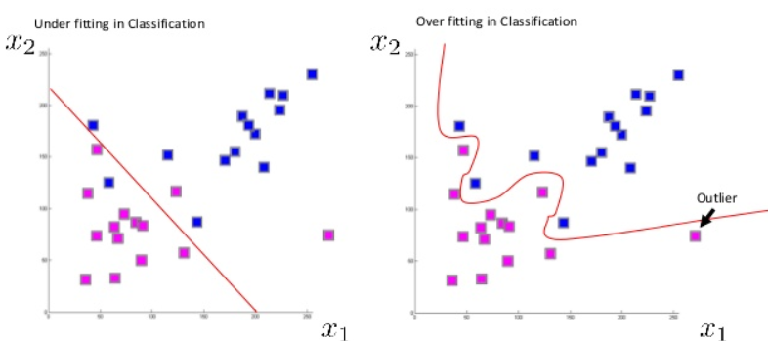

Regularization Parameter
Controls overfitting

Slide 30
Agenda
Apache Spark
Spark MLlib
Text Classification with Spark
Some other Machine Learning Concepts
Demo
Wrap-up

Slide 31

Demo Scenario
Text Classification against the 20 Newsgroup text classification data set using Spark machine learning
We will specifically classify the documents into two categories
a binary classification

Slide 32

20 Newsgroups Data Set
Collection of approximately 20,000 newsgroup documents
partitioned (nearly) evenly across 20 different newsgroups, each corresponding to a different topic
Popular data set for experiments in text applications of machine learning techniques
In this demo, we will only use a subset of the 20 Newsgroups data set
2000 articles
100 articles from each of the 20 newsgroups
Acknowledgement:
Hettich, S. and Bay, S. D. (1999). The UCI KDD Archive [http://kdd.ics.uci.edu]. Irvine, CA: University of California, Department of Information and Computer Science.

Slide 33
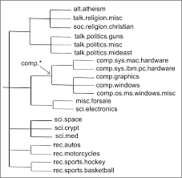
20 Newsgroups Data Set Topics
comp.graphics
comp.os.ms-windows.misc
comp.sys.ibm.pc.hardware
comp.sys.mac.hardware
comp.windows.x
rec.autos
rec.motorcycles
rec.sport.baseball
rec.sport.hockey
sci.crypt
sci.electronics
sci.med
sci.space
misc.forsale
talk.politics.misc
talk.politics.guns
talk.politics.mideast
talk.religion.misc
alt.atheism
soc.religion.christian

Slide 34
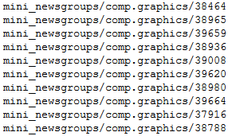
20 Newsgroups Data Set Format
The articles from each of the 20 Newsgroups are arranged by topic in filesystem directories
20 directories, one per topic
100 files in each directory, one file = one document
The subdirectory name, representing the topic, will be used for labeling the data to train the machine learning algorithm

Slide 35

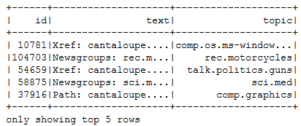
Demo Flow
Download the data in tarball format
mini_newsgroups.tar.gz
Explode the tarball
tar –zxvf mini_newsgroups.tar.gz
Read the newsgroups documents into an RDD
wholeTextFiles lets you read in a directory structure containing multiple small text files and returns each as (filepath, content) pairs
Strip out the filepath and text from the (filepath, content) pairs
Extract the topic from the filepath
Put the data into a DataFrame

Slide 36
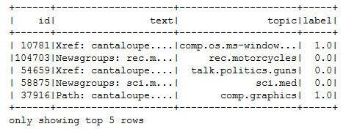
Demo Flow (continued)
Label the data as to whether each document is computer related or not
Binary classification
Label directories that contain “comp” as computer related, others as not
label = 0 => non- computer related
Label = 0 => computer related
Split the data set into training (90%) and test (10%)

Slide 37
Demo Flow (conclusion)
Configure the Machine Learning pipeline
Tokenizer
Stop Words Remover
Hashing TF
Inverse Document Frequency
Logistic Regression
Fit the pipeline to the training documents
Show predictions on the test data set
Tune the pipeline
Using an evaluator for the binary classification (Area under the ROC curve)
Generate hyperparameter combinations using a parameter grid
Create a cross validator to tune the pipeline
Cross-evaluate the machine learning pipeline
Investigate improvements achieved by tuning hyperparameters using cross-evaluation
Make improved predictions using the best fit model

Slide 38
Agenda
Apache Spark
Spark MLlib
Text Classification with Spark
Some other Machine Learning Concepts
Demo
Wrap-up

Slide 39
Summary
The goal of text classification is the classification of text documents into a fixed number of predefined categories
Text classification has a number of applications ranging from email spam detection to providing news feed content to users based on user preferences
The example shown was intended to illustrate how to use Spark MLlib to implement a machine learning pipeline
Although a document classification use case was specifically demonstrated, many of the principles demonstrated in the notebook can be employed to other machine learning use cases
MLlib provides a set of high-level APIs for constructing, evaluating and tuning a machine learning workflow
Spark represents a workflow as a pipeline, which consists of a sequence of stages to be run in a specific order

Slide 40


Slide 41


Slide 42


